Slide 1

2017
2018
2019
2020
2021
https://bit.ly/SxB5YA
Title
Spotify x Billboard Chart Albums Analysis Project

Slide 2

PRESENTERS

Slide 3
PRESENTERS
BIANCA SERRANO
Educational background in psychology
Currently employed as a data coordinator
5 years experience in database management
Skills in:
Case management in government and educational systems
Reporting and data synthesis for presentation in Excel and government database systems
Interested in music through a background in event music curation and

Slide 4
PRESENTERS
KATIE RAVENWOOD
Educational background in music & biochemistry
Currently employed as a musician & music teacher
25 years experience in music performance and music education
20 years of web development & marketing experience
Skills in:
Business administration and marketing
Contracting and contract negotiation
Front end design and development
Educational and curriculum design
Interest in music through a background in performance and concert promotion

Slide 5
BACKGROUND

Slide 6


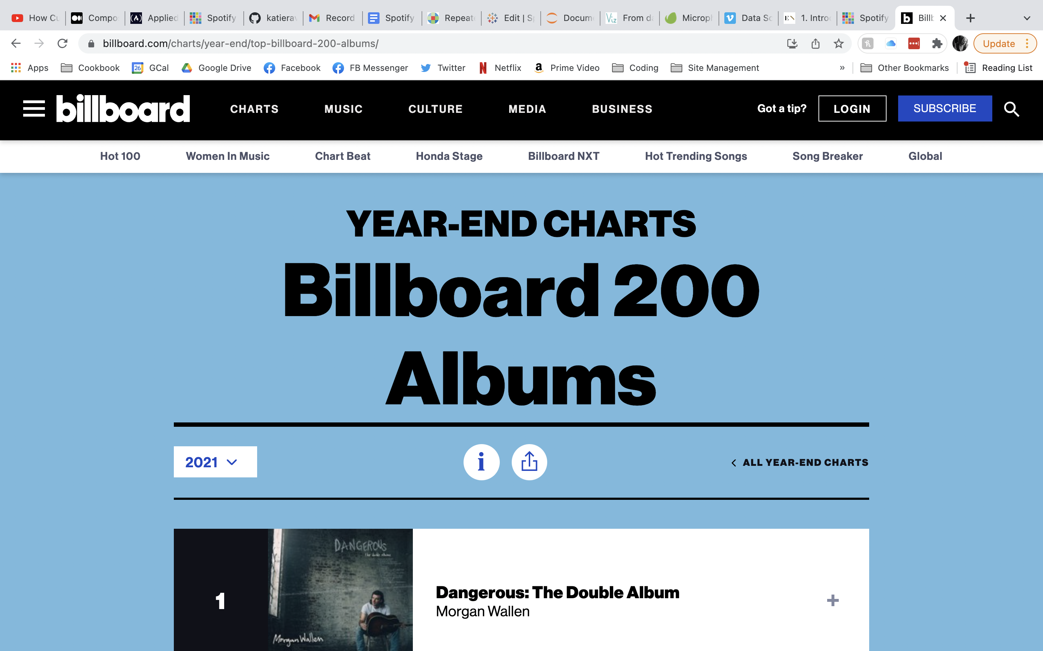
Billboard is an American music and entertainment magazine published weekly by the Billboard-Hollywood Reporter Media Group, a division of MRC Media & Info.
The Billboard charts tabulate the relative popularity of songs and albums in the United States and
The yearly 200 album chart lists the year's most popular albums across all genres.
Albums are ranked by album sales as well as audio on-demand streaming activity and digital sales of tracks from albums as compiled by Nielsen Music.

Slide 7


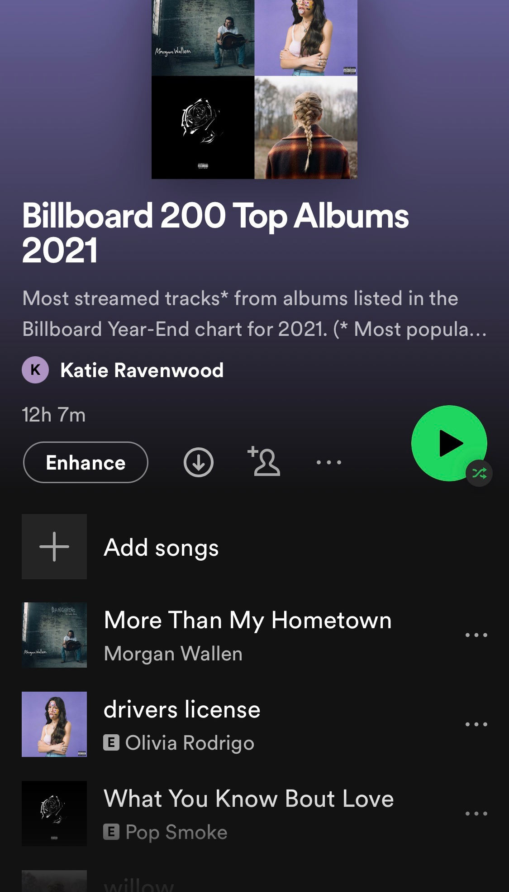
DESCRIPTION
Suitable for all categories business and personal presentation
DESCRIPTION
Suitable for all categories business and personal presentation
DESCRIPTION
Suitable for all categories business and personal presentation
DESCRIPTION
Suitable for all categories business and personal presentation

Slide 8

METHODS

Slide 9

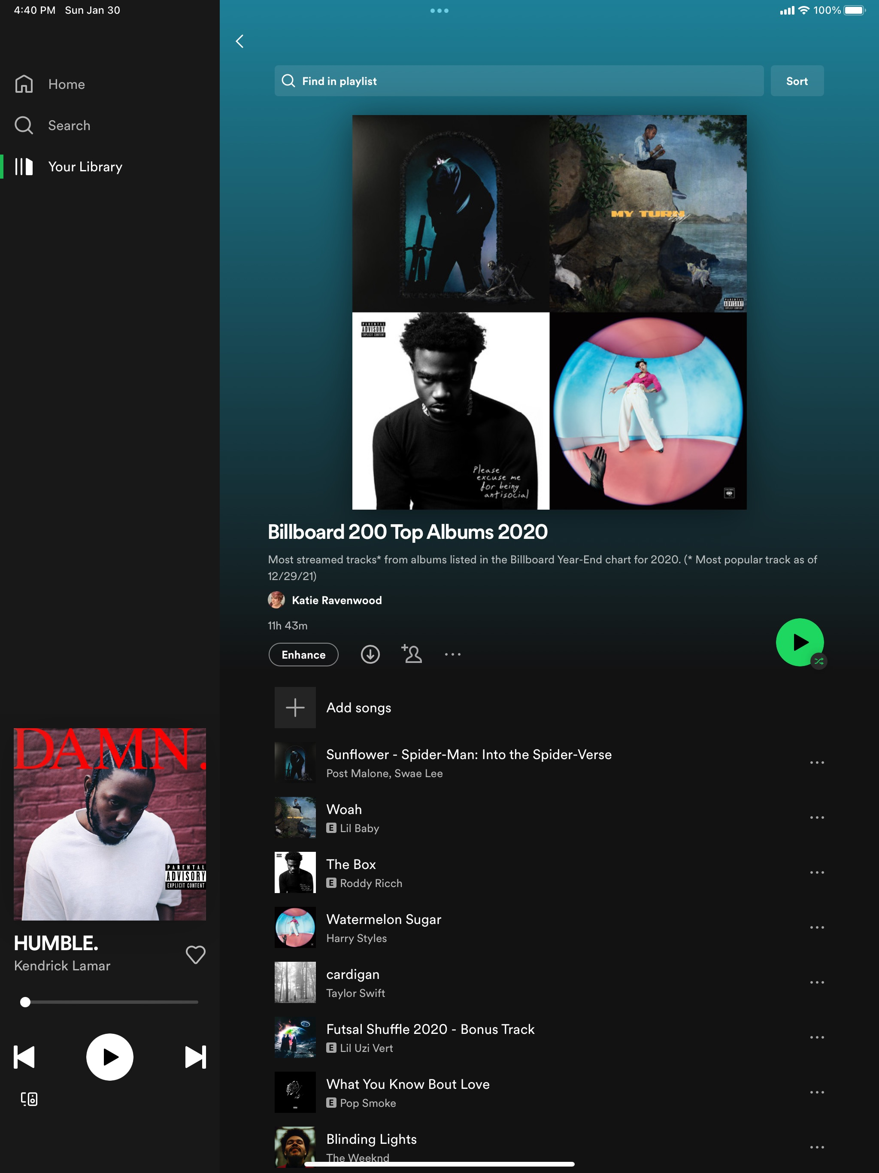
DATASET CREATION
PYTHON & SPOTIPY
Data tables of album and track information created with Python using the SpotiPy package.
Playlists of each
chart were
created in Spotify
to provide endpoints
for accessing chart data.
Included variables:
Billboard Album Chart Name & Year
Album ID, Name, Release Year
Album artists' names, IDs, popularity, and associated genres
Track artists' names, IDs, popularity, and associated genres
Explicit labeling designation
Audio features
SPOTIFY PLAYLISTS
01.
Billboard 200 Top Albums 2017
02.
Billboard 200 Top Albums 2018
03.
Billboard 200 Top Albums 2019
04.
Billboard 200 Top Albums 2020
05.
Billboard 200 Top Albums 2021

Slide 10





DATA WRANGLING
JOINS
FEATURES
TRACK & ALBUM
TABLES
CLEANING &
DUMMY CODING
Multiple joins for various charts and analyses
Removing null values and dummy coding genres for analysis
GENRES
DATES
UN-NESTING LISTS
RECODING TO DATETIME
Wrangling nested lists of genres linked by artist
Recoding release dates and chart years to datetime format

Slide 11

RESULTS

Slide 12

Interesting Data Points
Shape of the dataframe: 16,501 rows and 57 variables
Most popular song: ”good for you” by Olivia Rodrigo and “Woman” by Doja Cat
Average song length: 3 minutes and 22 seconds
Longest song: “Like I Never Left” by Future at 25 minutes 33 seconds
Most frequently appearing album artist: Drake (31 times)
Appearances by Taylor Swift (15), Queen (7), and Elton John (4)
Oldest track: “The Christmas Song (Merry Christmas To You” released in 1962
Newest track: “Bad Morning” by Young Boy Never Broke Again released October 5, 2021.

Slide 13
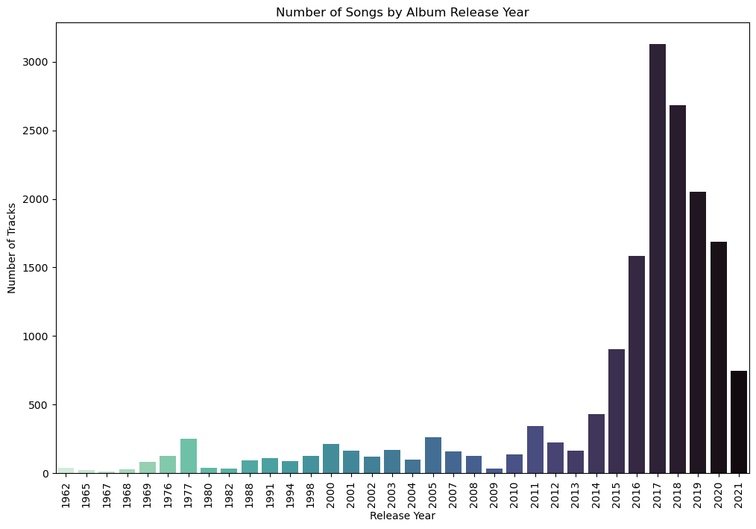
NUMBER OF TRACKS BY RELEASE YEAR

Slide 14
VOLUME CHART
65%
93%
76%
84%
SOUND
PITCH
BASS
TREBLE
Suitable for all categories business and personal presentation
Suitable for all categories business and personal presentation
Suitable for all categories business and personal presentation
Suitable for all categories business and personal presentation

Slide 15
OUR PORTFOLIO
PORTFOLIO 02
PORTFOLIO 04
Suitable for all categories business and personal presentation
Suitable for all categories business and personal presentation
PORTFOLIO 01
PORTFOLIO 03
Suitable for all categories business and personal presentation
Suitable for all categories business and personal presentation

Slide 16
MUSIC
ARTIST
SONGS
ALBUM
EVENTS
YOURWEBSITE.COM
Title
Subtitle

Slide 17
AGENDA PLAYLIST
ABOUT US
MEET THE TEAM
PORTFOLIO
CHART
TESTIMONIAL
THANK YOU

Slide 18
WELCOME
ALBERT HEINZ
CEO/FOUNDER
“ A wonderful serenity has taken possession of my entire soul, like these sweet mornings of spring which I enjoy with my whole heart. I am alone, and feel the charm of existence in this spot, which was created for the bliss of souls like mine. “

Slide 19
ABOUT US
A collection of textile samples lay spread out on the table - Samsa was a travelling salesman - and above it there hung a picture that he had recently cut out of an illustrated magazine and housed in a nice, gilded frame. It showed a lady fitted out with a fur hat and fur boa who sat upright, raising a heavy fur muff that covered the whole of her lower arm towards the viewer. Gregor then turned to look out the window at the dull weather.
PLAY
FOLLOW

Slide 20
OUR MISSION
A small river named Duden flows by their place and supplies it with the necessary regelialia. It is a paradisematic country, in which roasted parts of sentences fly into your mouth. Even the all-powerful Pointing has no control about the blind texts it is an almost unorthographic life One day however a small line of blind text
DESCRIPTION
DESCRIPTION
DESCRIPTION
DESCRIPTION
Suitable for all categories business and personal presentation
Suitable for all categories business and personal presentation
Suitable for all categories business and personal presentation
Suitable for all categories business and personal presentation

Slide 21

OUR SERVICE
DESCRIPTION
Suitable for all categories business and personal presentation
DESCRIPTION
Far far away, behind the word mountains, far from the countries Vokalia and Consonantia, there live the blind texts. Separated they live in Bookmarksgrove right at the coast of the Semantics,
Suitable for all categories business and personal presentation
DESCRIPTION
Suitable for all categories business and personal presentation
DESCRIPTION
Suitable for all categories business and personal presentation

Slide 22
OUR TIMELINE
2015
2016
DESCRIPTION
DESCRIPTION
Suitable for all categories business and personal presentation
Suitable for all categories business and personal presentation
2017
2018
DESCRIPTION
DESCRIPTION
Suitable for all categories business and personal presentation
Suitable for all categories business and personal presentation

Slide 23
SECTION BREAK

Slide 24
MEET THE TEAM
COURTNEY LOVE
Musician
One morning, when Gregor Samsa woke from troubled dreams, he found himself transformed in his bed into a horrible vermin. He lay on his armour-like back, and if he lifted his head a little he could see his brown belly,
NEW
ALBUM
LINDSAY
SEBASTIAN
JENNIFER
LAURENT
JAMES

Slide 25
THE BEST TEAM
A wonderful serenity has taken possession of my entire soul, like these sweet mornings of spring which I enjoy with my whole heart. I am alone, and feel the charm of existence in this spot, which was created for the bliss of souls
CARMILA LOPEZ
JONATHAN DAVE
Editor
Composer

Slide 26
PROFILE TEAM
MICHAEL DOWNEY
Music Director
One morning, when Gregor Samsa woke from troubled dreams, he found himself transformed in his bed into a horrible vermin. He lay on his armour-like back, and if he lifted his head a little he could see his brown belly,
Skill 01
Skill 02
Skill 03

Slide 27
OUR PORTFOLIO
PORTFOLIO 02
PORTFOLIO 04
Suitable for all categories business and personal presentation
Suitable for all categories business and personal presentation
PORTFOLIO 01
PORTFOLIO 03
Suitable for all categories business and personal presentation
Suitable for all categories business and personal presentation

Slide 28
OUR PORTFOLIO
ARTIST 01
Suitable for all categories business and personal presentation
03:52
ARTIST 02
Suitable for all categories business and personal presentation
05:17
ARTIST 03
Suitable for all categories business and personal presentation
04:39

Slide 29
OUR WORKS
TOP 10 CHART
01
When The Rain Falls
Sugar head
4:43
02
Symphony Day
Eva Mendez
6:25

Slide 30


LATEST PROJECT
ARTIST NAME
ALBUM NAME : PROJECT
Indie Folk
2019
SONGLIST
The Big Oxmox advised her not to do so, because there were thousands of bad Commas, wild Question Marks and devious Semikoli, but the Little Blind Text didn’t listen.
01.
Add Song Title
3:56
02.
Add Song Title
4:12
03.
Add Song Title
3:38
04.
Add Song Title
4:27
BUY NOW
05.
Add Song Title
5:00

Slide 31
MUSIC EVENT
EVENT NAME
23 Apr 2019
Far far away, behind the word mountains, far from the countries Vokalia and Consonantia, there live the blind texts. Separated they live in Bookmarksgrove right at the coast of the Semantics,
“ Music is a moral law. It gives soul to the universe, wings to the mind, flight to the imagination, and charm and gaiety to life and to everything. “

Slide 32
SMARTPHONE MOCKUP
A wonderful serenity has taken possession of my entire soul, like these sweet mornings of spring which I enjoy with my whole heart. I am alone, and feel the charm of existence in this spot, which was created for the bliss of souls
DOWNLOAD
OPTION
UPDATE
Suitable for all categories business and personal presentation
Suitable for all categories business and personal presentation
Suitable for all categories business and personal presentation

Slide 33
LAPTOP MOCKUP
DISCOVER YOUR MUSIC
One morning, when Gregor Samsa woke from troubled dreams, he found himself transformed in his bed into a horrible vermin. He lay on his armour-like back, and if he lifted his head a little
Our Product
Competitor Product

Slide 34
TABLET MOCKUP
PLAY YOUR FAVOURITE MUSIC
One morning, when Gregor Samsa woke from troubled dreams, he found himself transformed in his bed into a horrible vermin. He lay on his armour-like back, and if he lifted his head a little he could see his brown belly,
6,350
5,860
2,910
3,100
1,540

Slide 35
NOW PLAYING – VARIOUS ARTIST

Slide 36
OUR FLOWCHART
STEP 02
STEP 04
Suitable for all categories business and personal presentation
Suitable for all categories business and personal presentation
STEP 01
STEP 03
STEP 05
Suitable for all categories business and personal presentation
Suitable for all categories business and personal presentation
Suitable for all categories business and personal presentation

Slide 37
ANNUAL REPORT
DESCRIPTION
A small river named Duden flows by their place and supplies it with the necessary regelialia. It is a paradisematic country, in which roasted parts of sentences fly into your mouth. Even the all-powerful Pointing has no control about the blind texts
READ MORE
JAN
FEB
MAR
APR
MAY
JUN
JUL
AUG
SEP
OCT
NOV
DEC
80,450
$21M
97%
83%
Premium Users
Profit / Year
People Love
People Liked

Slide 38
VOLUME CHART
65%
93%
76%
84%
SOUND
PITCH
BASS
TREBLE
Suitable for all categories business and personal presentation
Suitable for all categories business and personal presentation
Suitable for all categories business and personal presentation
Suitable for all categories business and personal presentation

Slide 39
SALES CHART
713,650,000
62%
A collection of textile samples lay spread out on the table - Samsa was a travelling salesman - and above it there hung a picture that he had recently cut out of an illustrated magazine and housed in a nice, gilded frame.
Suitable for all categories business and personal presentation
$425,000
$437,120
$405,685
$310,000
$318,250

Slide 40
WORLDWIDE MARKET
+78%
+6925
Suitable for all categories business and personal presentation
+7520
+4300
72%
89%
+8210
A wonderful serenity has taken possession of my entire soul, like these sweet mornings of spring which I enjoy with my whole heart.
Far far away, behind the word mountains, far from the countries Vokalia and Consonantia, there live the blind texts. Separated they live in Bookmarksgrove right at the coast

Slide 41
AUSTRALIA MAP
DESCRIPTION
A small river named Duden flows by their place and supplies it with the necessary regelialia. It is a paradisematic country, in which roasted parts of sentences fly into your mouth. Even the all-powerful Pointing has no control about the blind texts
Region 01
70%
Region 02
90%
Region 03
80%

Slide 42
PRICE TABLE
FREE TRIAL
BASIC
PREMIUM
MENU
MENU
MENU
$0
$15
$25

Slide 43
OFFICIAL PARTNERS
SHANIA MENDEZ
Musician
“ I should be incapable of drawing a single stroke at the present moment; and yet I feel that I never was a greater artist than now. When, while the lovely valley teems with vapour around me “

Slide 44
OUR CONTACT
SONGS
ADDRESS
Padjadjaran Street No.393
Bandung, West Java
Indonesia 40232
ALBUM
PHONE
+123-456-7890
+987-654-3210
ARTIST
EMAIL
email@slidefactory.com
YOURWEBSITE.COM

Slide 45
THANK YOU
FOR
LISTENING

